Slide 1
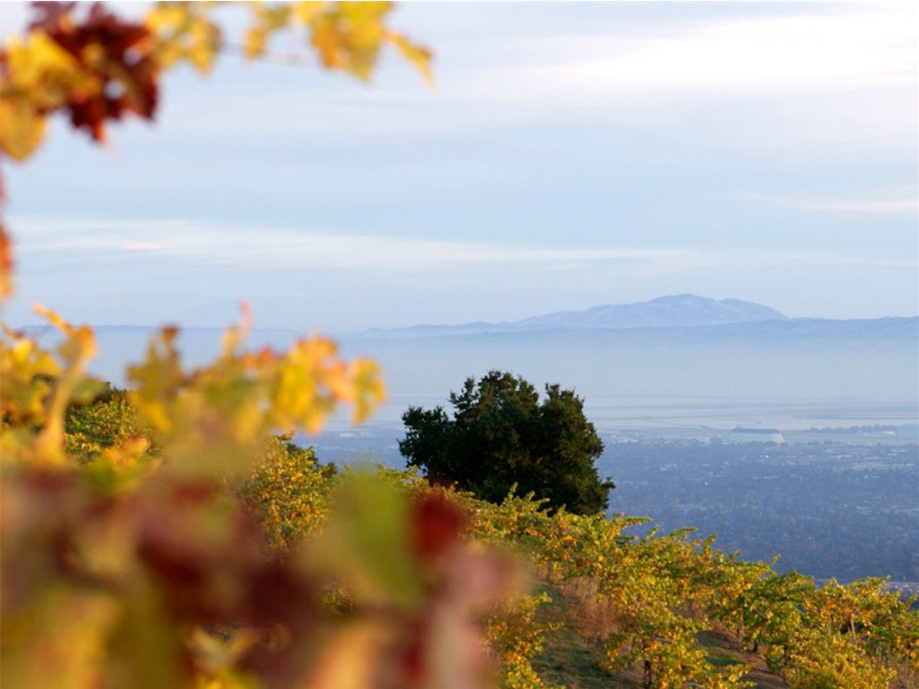
Exceptional single-vineyard wines since 1962.

Slide 2
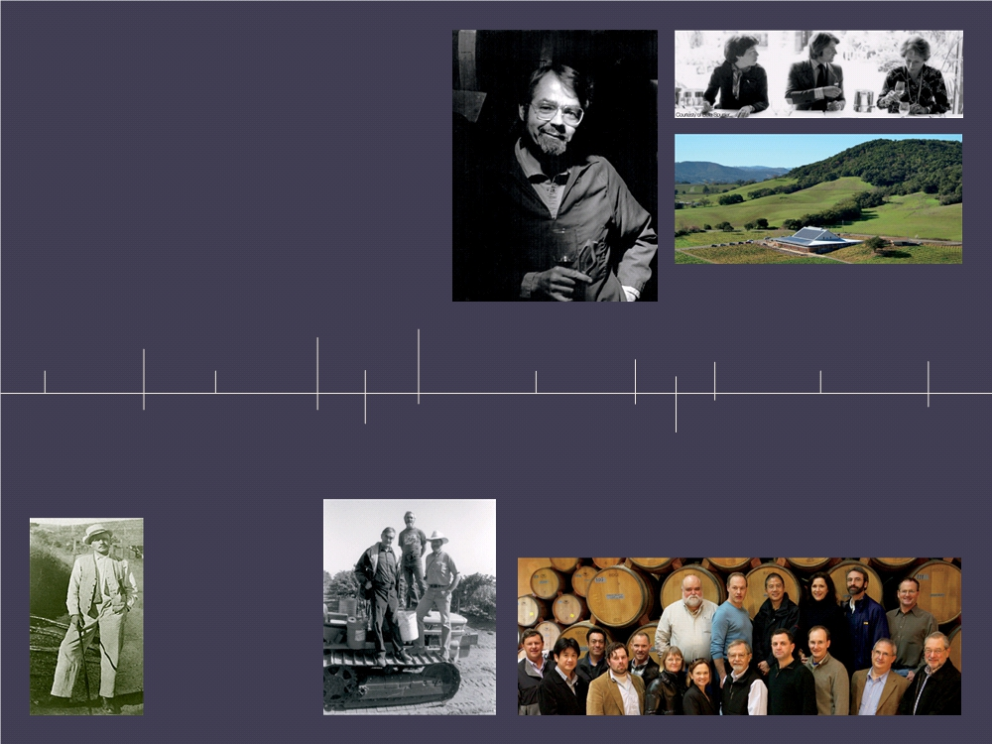
Historical
timeline
Dr. William Short, owner of the Torre vineyard adjacent to the Perrone property, replants several blocks of cabernet and one of chardonnay-the first on the ridge.
Ridge produces its first Geyserville, from vines planted in 1882 in Sonoma County.
The partners re-bond the winery and make their first Ridge Monte Bello.
Ridge produces the first Lytton Springs from vines planted in 1902.
Ridge buys the Lytton Springs winery and its old vineyards.
Ridge celebrates 50 year anniversary
1949
1885 1959
1964
1969
1976
2006
Dr. Osea Perrone of San Francisco buys 180 acres on Monte Bello ridge, plants vines, builds a stone winery.
Three scientists from
Stanford University’s
Research Institute
(SRI) and their families form a partnership and buy Dr. short’s property. One of them, David Bennion, makes a half barrel of cabernet from the ten year old vines.
1966
Paul Draper
joins Ridge
Vineyards as
winemaker.
1972 1991
30 year repeat of the Judgment of Paris. The 1971 and 2000 Monte Bello cabernets win first place in both the original vintage wine and new vintage wine categories in London and California.
1962
2012
They produce their first zinfandel from 19th century vines on the Pichetti ranch.
Judgment of
Paris

Slide 3
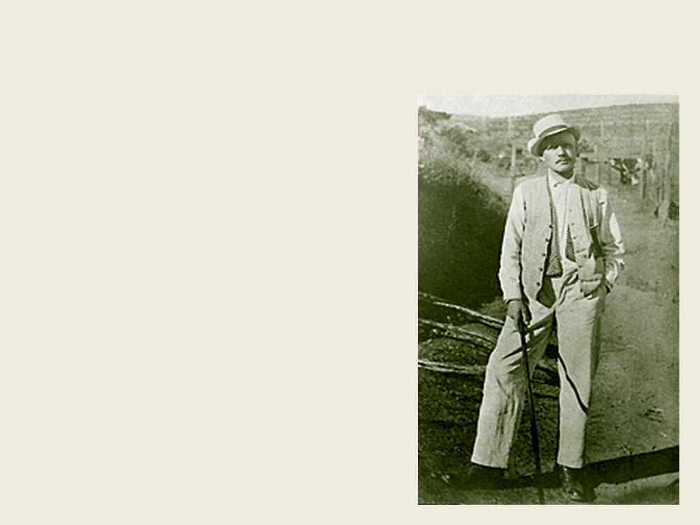
With a Doctor
it begins
1885 Dr. Osea Perrone from San
Francisco buys 180 acres on Monte
Bello Ridge.
1886 He plants vineyards and
begins construction on the stone and
redwood Monte Bello Winery.
1892 Construction completed on the
Montebello Winery and the first wine
under the Monte Bello label is produced.

Slide 4
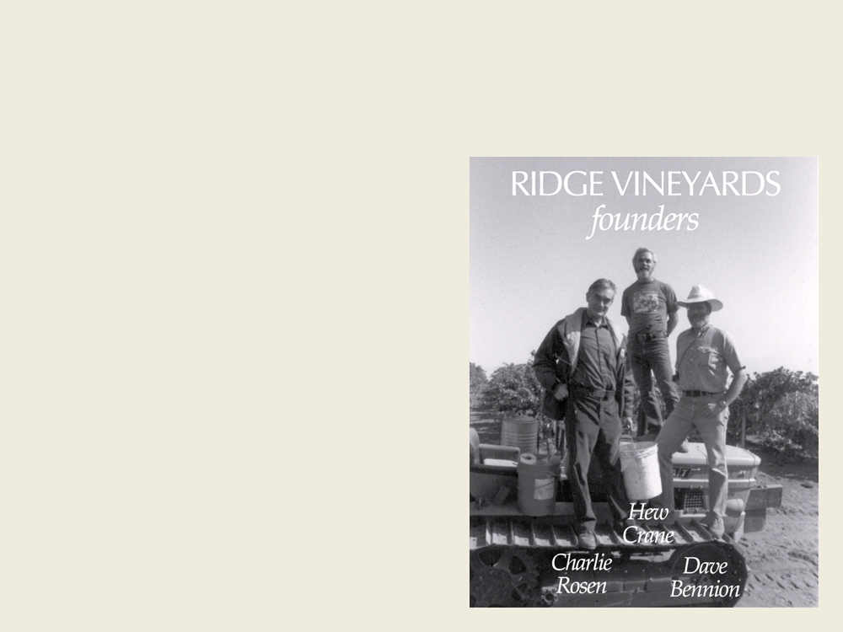
With Scientists
it continues
1959 Three scientists from Stanford
University’s Research Institute (SRI)
purchase the property and make a
small amount of wine from the ten
year old Cabernet vines in the small
winery on the property.
1962 The new owners form a part-
nership that becomes Ridge Vine-
yards. They re-bond the winery.
1969 Paul Draper joins Ridge Vine-
yards as winemaker.

Slide 5
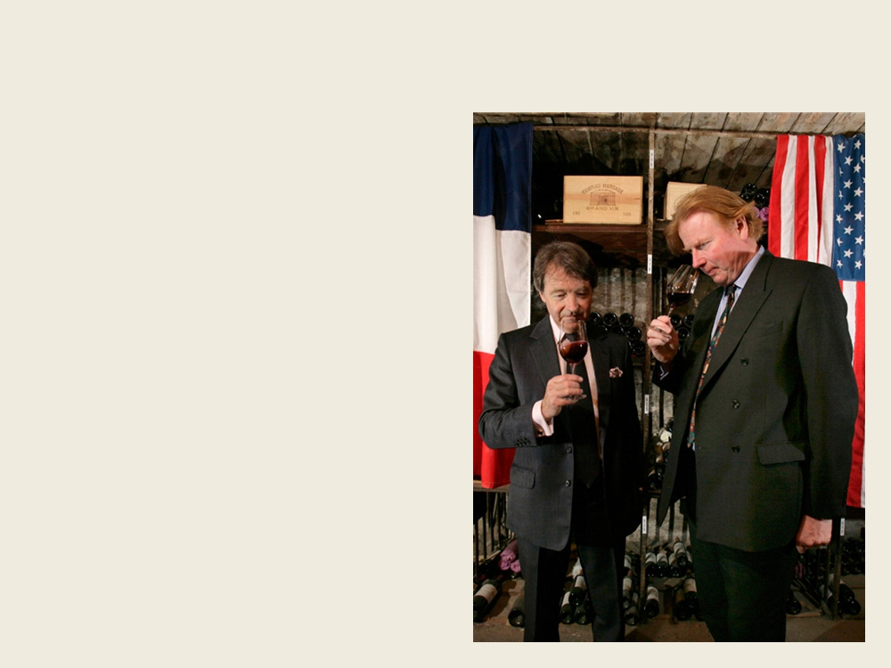
With Commitment
it succeeds
1976 Judgment of Paris, Ridge
places fifth.
2006 The 1971 and 2000 Monte
Bello cabernets win first place in
both the original vintage wine and
new vintage wine categories at the
“Judgment of Paris 30th Anniversary
Wine Tasting” which is held simulta-
neously in London and California.
2012 Ridge celebrates it’s 50 year
anniversary

Slide 6
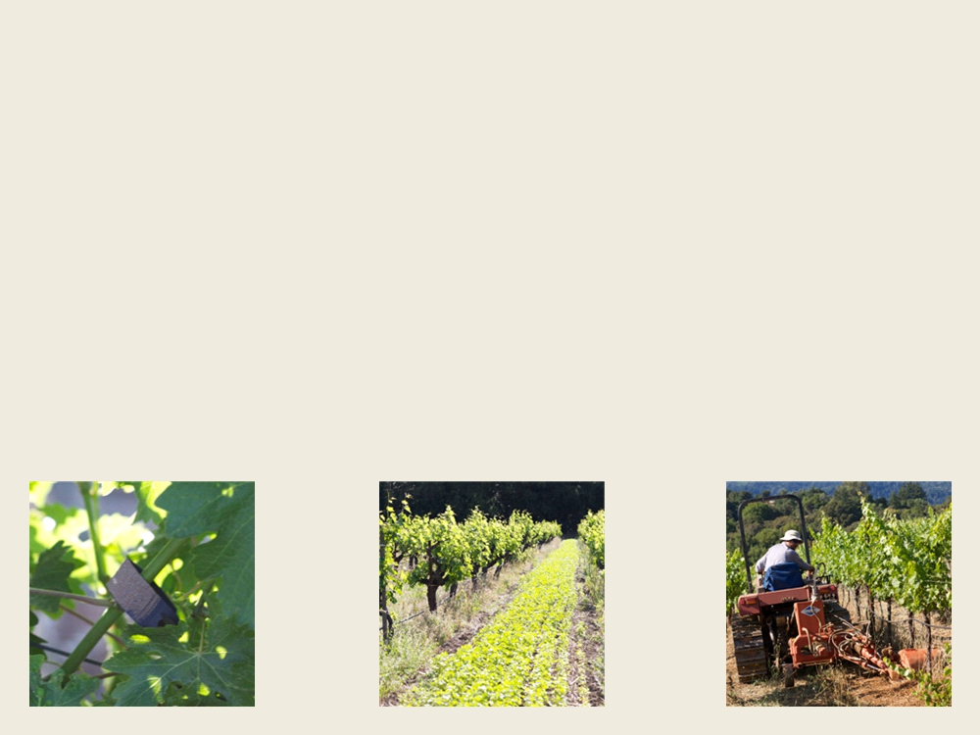
Organic & Sustainable
in the vineyard
The majority of our vineyards are certified organic, fully certified by 2013.
Compost: We compost all of our grape stems and pomace
Cover Crops: Soil-building legumes and grass mixes that add nitrogen and
organic matter; insectary plantings; erosion control
Insects: Instead of spray to control vine-damaging insects we use benefi-
cial insects.

Slide 7
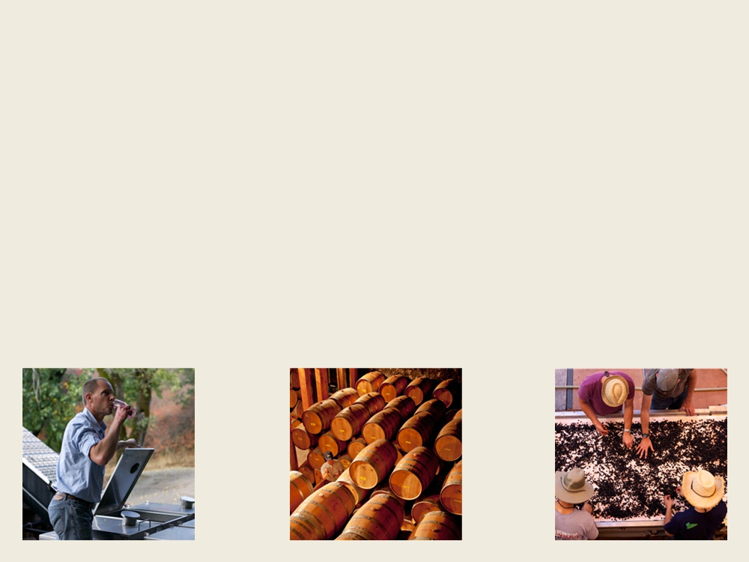
Winemaking
pre-industrial
Pre-industrial winemaking begins with respect for the natural process that
transforms fresh grapes into wine, and the 19th Century model of
minimum intervention.
When you have great vineyards that produce high quality grapes of dis-
tinctive individual character, this is not only an environmentally and so-
cially responsible approach, it’s also the best way to consistently make fine
wine.

Slide 8
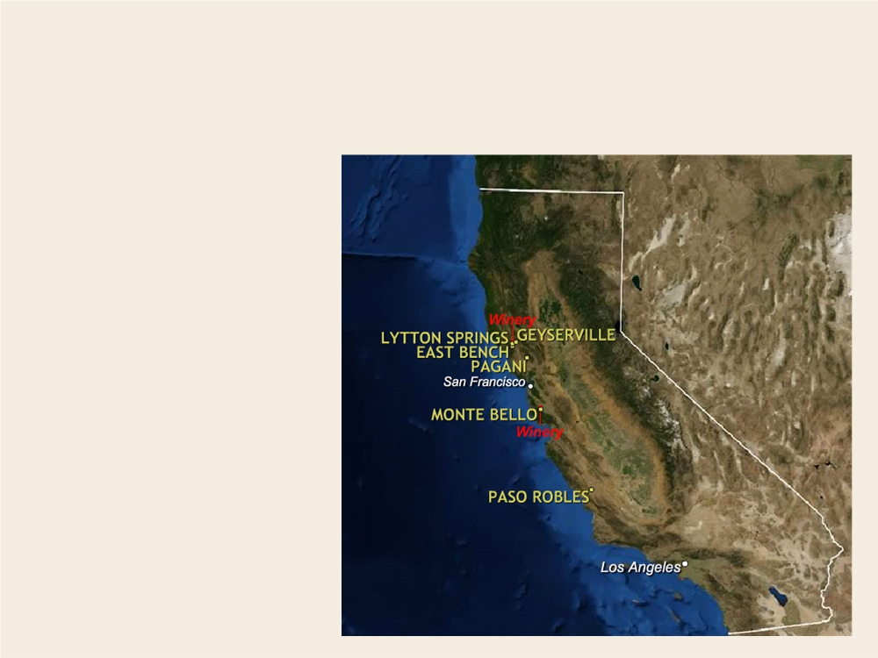
Location
Our Wineries
Monte Bello is located in
the Santa Cruz Mountains
in Cupertino.
Lytton Springs is locat-
ed in Sonoma County in
Healdsburg.

Slide 9
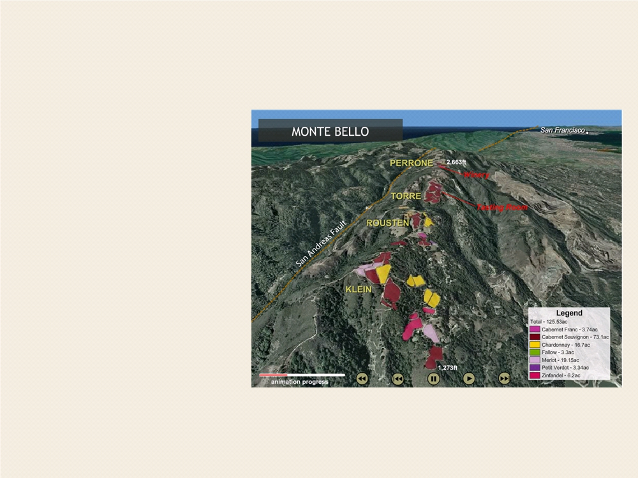
Monte Bello
Santa Cruz Mountains
Situated a mere 15 miles
from the Pacific Ocean,
sits high atop the Santa
Cruz Mountains AVA,
California’s coolest caber-
net producing area.
It is underlain by decom-
posing limestone, mak-
ing the soil composition
at Monte Bello a unique
and important contributor
to the wine’s distinctive
character.

Slide 10
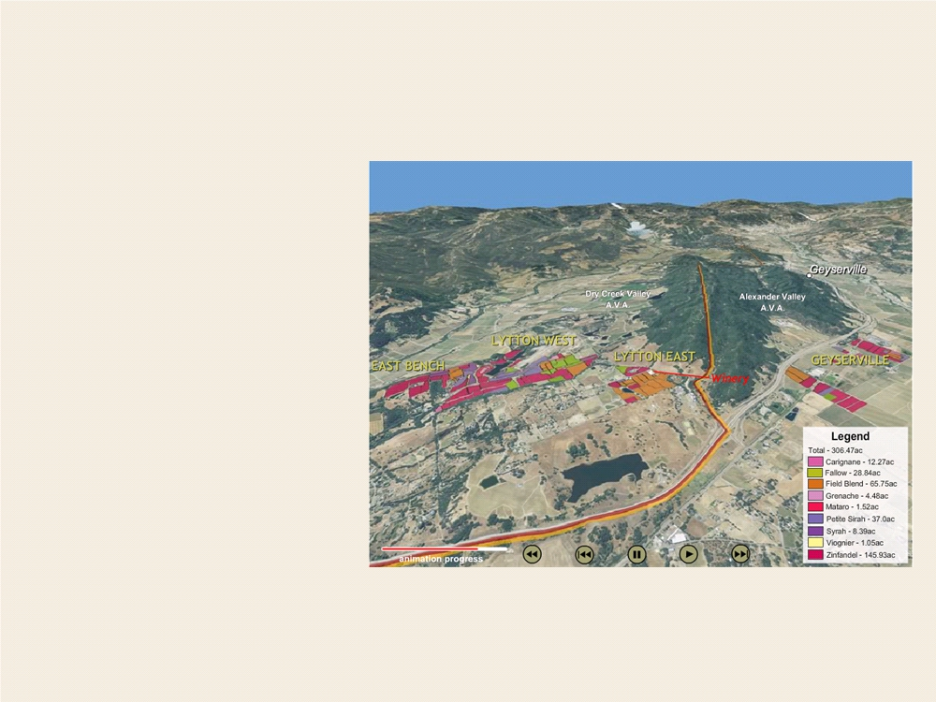
Lytton Springs
Sonoma County
Lytton Springs is home
to 100 plus-year-old zin-
fandel vines interplanted
with petite sirah, cari-
gnane, a small amount of
mataro (mourvèdre), and
grenache.
For more than three de-
cades the field blend from
this site has produced the
quintessential example of
Dry Creek Valley zinfan-
del.

Slide 11
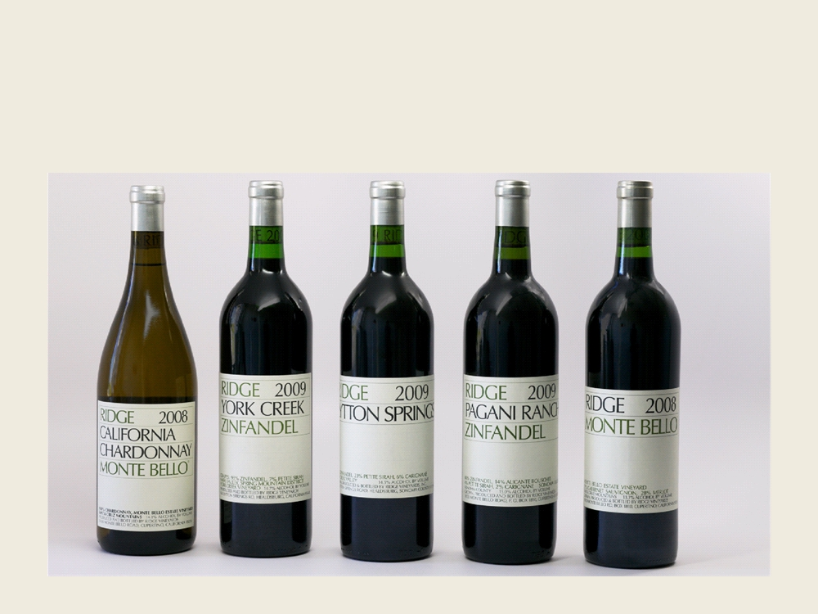
Fall Releases
from 2011

Slide 12
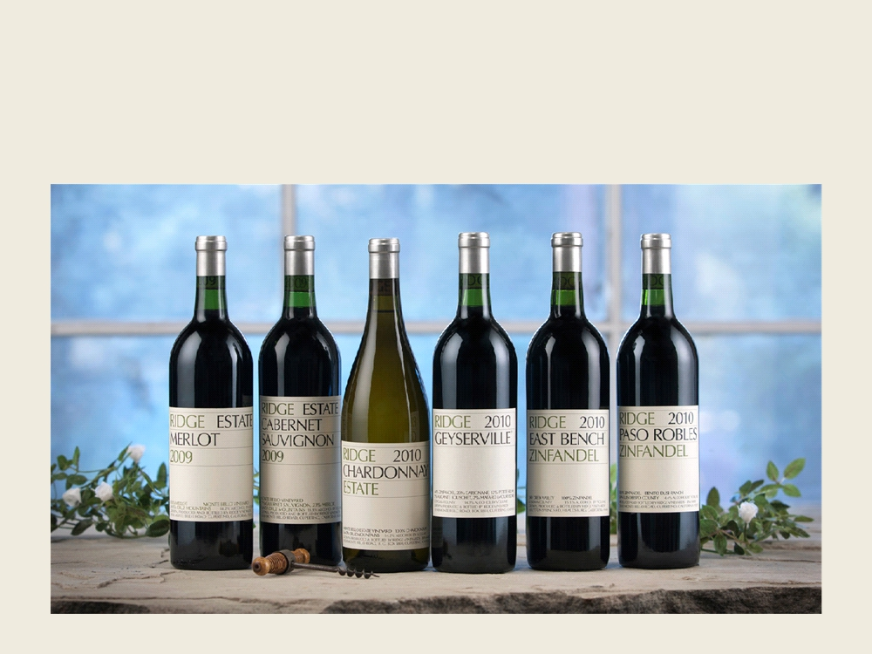
Spring Releases
from 2012

Slide 13
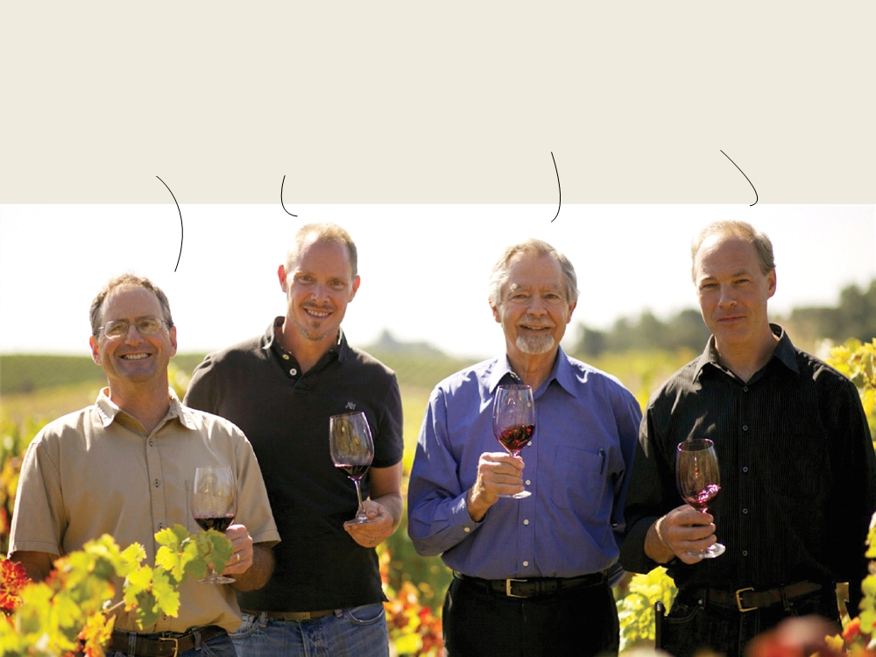
Our Team
winemaking
Paul Draper, every-
one knows him
John Olney, he
makes our wine at
Lytton Springs
David Gates, our Eric Baugher, the
vineyard guru guy making wine at
Monte Bello

